Slide 1

CS1020 Data Structures and Algorithms I Lecture Note #0
Course Admin
(AY2015/6 Semester 2)

Slide 2
Outline
Module Overview
Objectives
Staff
Resources
Schedules
Assessments

Slide 3
Module Overview
Object Oriented Programming (OOP) model
Using Java
Classic data structures
Lists, Stacks, Queues
Basic analysis of algorithm
Recursion
More advanced than CS1010
Sorting algorithms
More advanced than CS1010
Hashing
OOP
CS1010
CS1020
CS2010
Algorithms
Linear Data Structures
[CS1020 Lecture 0: Course Admin]

Slide 4
Objectives
With this course, you should be able to:
Use object oriented modeling to formulate solution
Utilize appropriate simple data structures in problem solving
Understand data abstraction
Understand recursion
Understand program efficiency through analysis of algorithms
[CS1020 Lecture 0: Course Admin]

Slide 5
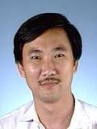
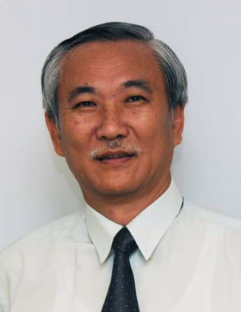
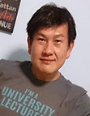
Lecturers
Module coordinator
A/P Tan Sun Teck COM2-03-02 tanst@comp.nus.edu.sg
Sectional Group 2 @ ICube Auditorium
Mr. Aaron Tan Tuck Choy COM1-03-12 tantc@comp.nus.edu.sg
Sectional Group 1 @ SR1
[CS1020 Lecture 0: Course Admin]

Slide 6

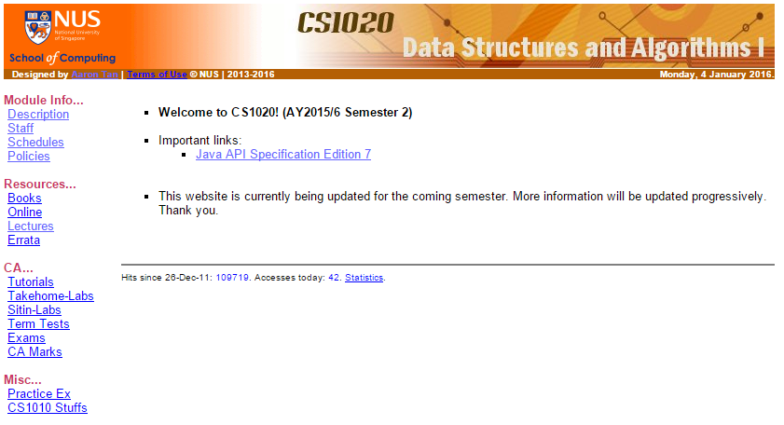
Module website
Resources
http://www.comp.nus.edu.sg/~cs1020
[CS1020 Lecture 0: Course Admin]

Slide 7
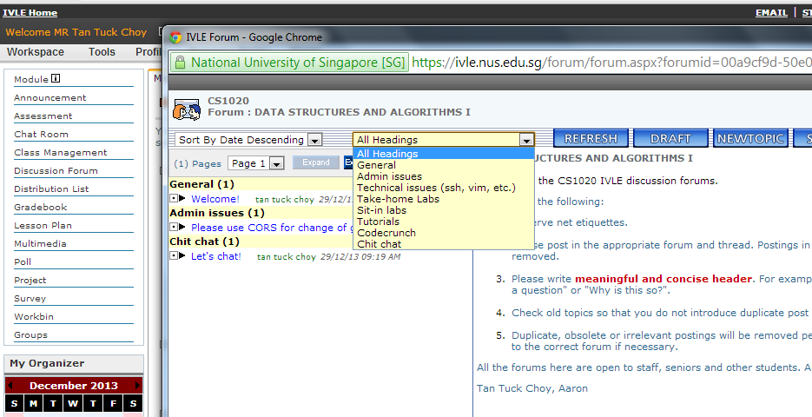
IVLE
https://ivle.nus.edu.sg
Resources
Announcements: Check daily
Forums: Use appropriate heading when you post
[CS1020 Lecture 0: Course Admin]

Slide 8
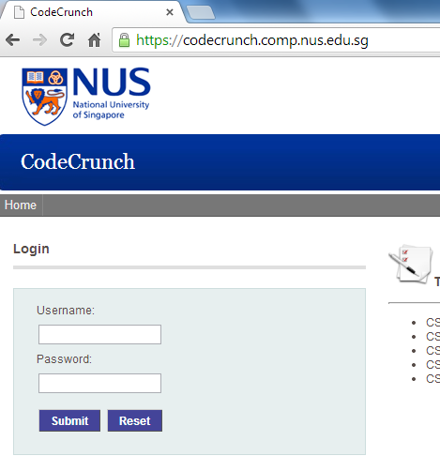
CodeCrunch
Resources
http://codecrunch.comp.nus.edu.sg
[CS1020 Lecture 0: Course Admin]

Slide 9
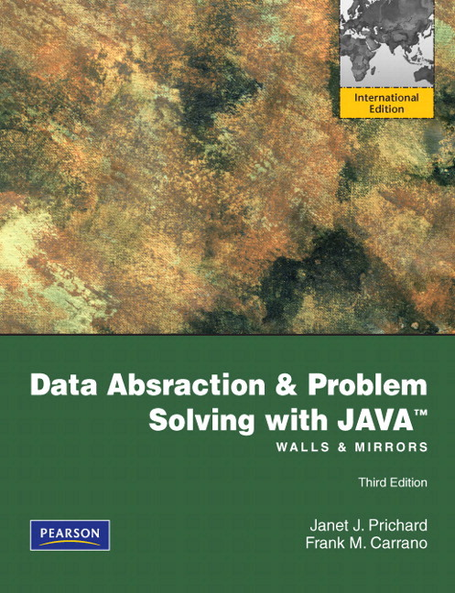
Textbook
Resources
Data Abstraction and Problem Solving with Java: Walls and Mirror
International edition, 3rd ed
Authors: Janet J. Prichard and Frank M. Carrano
Publisher: Pearson
ISBN: 9780273751205
Available at NUS Co-op @ Forum
Textbooks for loan
For needy students
Please refer to IVLE forum for details
[CS1020 Lecture 0: Course Admin]

Slide 10

Textbook
Resources
Promotion period:
11th to 15th January 2016.
[CS1020 Lecture 0: Course Admin]

Slide 11
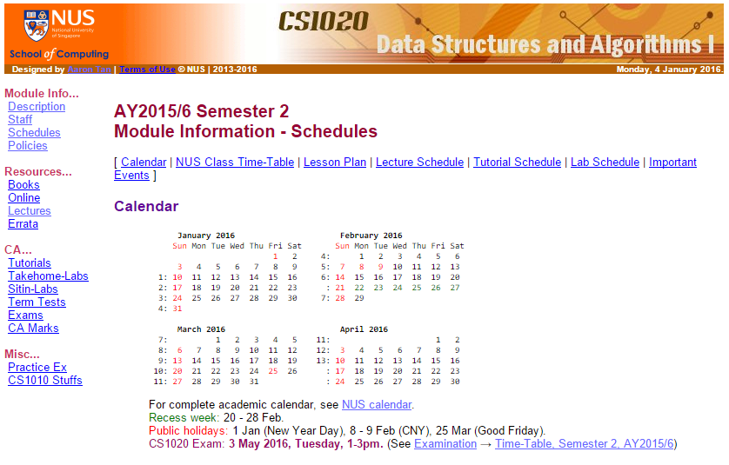
Schedules
http://www.comp.nus.edu.sg/~cs1020/1_module_info/sched.html
[CS1020 Lecture 0: Course Admin]

Slide 12
Assessments: Overview
http://www.comp.nus.edu.sg/~cs1020/1_module_info/desc.html
There will be 6 take-home labs (inclusive of lab #0), 4 graded sit-in labs and a practical exam (PE).
Take-home labs and sit-in labs are held in alternate weeks. Sit-in labs are open-book but electronic devices (eg: labtops and thumb-drives) are not allowed.
Activities | Weightages
Tutorial attendance/participation | 5%
Lab attendance | 2%
Take-home labs | 5%
Sit-in labs | 18%
Practical exam | 15%
Mid-term Test | 15%
Final Exam | 40%
Tutorials and labs start in week 3
Mid-term test and final exam are closed-book (no cheat sheet allowed)
[CS1020 Lecture 0: Course Admin]

Slide 13
Laboratory sessions
Assessments
See module website for updates
Actual lab session starts from week 3
A special lab #0 (1%) will be released in week 1
Familiarize yourself with the UNIX system and vim
Two types of lab session:
Take-home labs
5 sessions (best 4 out of 5 sessions; total = 4%)
Total: 4% + 1% (lab #0) = 5%
Sit-in labs
4 sessions, 6% per session
Total: 18% (Best 3 out of 4 sessions)
[CS1020 Lecture 0: Course Admin]

Slide 14
Take-home Labs
6 take-home labs (including lab #0)
Released on CodeCrunch
Each lab consists of 3 exercises
You should attempt them before attending the lab
Only one of them will be graded
During the lab session, your lab TA will:
Discuss possible approaches
Cover additional syntax (if any) or other related exercises/topics
Lab attendance: 2%
Each take-home lab (except lab #0) is worth 1%
Must be submitted to CodeCrunch BEFORE deadline
Must obtain an ‘A’ for the graded exercise.
Assessments
[CS1020 Lecture 0: Course Admin]

Slide 15
Sit-in Labs
There are 4 sit-in labs
A sit-in lab is like a mini practical exam to test your programming skills
Each sit-in lab is:
1 hour 40 minutes in duration and worth 6%
Open book, but limited to printed material only
API will be available on the computer
Your best 3 sit-in labs out of 4 will be chosen
Total: 18%
You will be allowed to take a makeup only if
You missed 2 or more sit-in labs with valid medical certificates or official excuses
Assessments
[CS1020 Lecture 0: Course Admin]

Slide 16
Sit-in Labs: Marking Scheme (1/2)
Assessments
Correctness: 70 marks
Input: 10% (Correctly read in all input and used them)
Output: 10% (Output format only, not about correct result)
Correctness: 50% (partial credit will be given)
Programming style: 30%
Modularity: 10%
Meaningful comments: 10%
Particulars
A description for each user-defined method
Appropriate pre- and post-conditions
Other comments to explain complex codes
Meaningful/descriptive identifiers: 5%
Proper indentation: 5%
Programming Style marks will be given only if you score at least 20 marks for correctness.
[CS1020 Lecture 0: Course Admin]

Slide 17
Sit-in Labs: Marking Scheme (2/2)
Assessments
Penalties:
50% will be deducted if the submitted program has syntax error.
Commented codes are ignored in general.
[CS1020 Lecture 0: Course Admin]

Slide 18
Practical Exam
Assessments
Date: 2nd April
Time: 10am to 3pm
Venue: PL labs in COM1 basement
Open-book, similar to sit-in labs
Marking scheme is the same as sit-in labs
[CS1020 Lecture 0: Course Admin]

Slide 19
Lab Schedules (Tentative)
Plan is tentative. Refer to module website for the most up-to-date plan.
Assessments
Week | Date | Type | Topics
1 | 14th Jan | Special | Intro Workshop
1 | -- | Take-home #0 | Basic Java/IO
3 | 28th Jan | Take-home #1 | Basic Java/Array
4 | 4th Feb | Sit-in #1 | Basic Java/Array
5 | 11th Feb | Take-home #2 | OOP
6 | 18th Feb | Sit-in #2 | OOP
7 | 3rd Mar | Take-home #3 | Linked List
8 | 10th Mar | Sit-in #3 | Linked List
9 | 17th Mar | Take-home #4 | Stack/Queue
10 | 24th Mar | Sit-in #4 | Stack/Queue
11 | 31st Mar | Take-home #5 | PE Practice
[CS1020 Lecture 0: Course Admin]

Slide 20
Assumptions
Or what we assume you should have learned in CS1010/CS1010J/CS1010S/CS1101S
Topics in C / Java / Python / Javascript
Program development
Writing pseudocodes
Edit – compile – execute” cycle
Step-wise refinement
Hand-tracing codes
Incremental coding
Testing
Debugging
Problem solving
Programming environment/tools
Class exercises
Practice exercises
Lab assignments
Operating system: UNIX
Editor: vim
Debugger: (eg: gdb)

Slide 21
Summary and advice (1/2)
The labs focus more on your programming skills:
Ability to translate idea into actual program
Midterm and final exam focus more on your problem-solving skills:
Ability to understand and reason about the problem
Ability to apply your knowledge to formulate solution
You need to spend time on:
Actually coding to improve your skill
Thinking deep and exploring as memorization does not help
Asking questions! (Use the IVLE forums.)
[CS1020 Lecture 0: Course Admin]

Slide 22



Summary and advice (2/2)
We provide you
Practice exercises on CodeCrunch
Self-assessments (quizzes) on IVLE
Help sessions (on request)
But, ultimately…
must be prepared and willing to
put in a lot of efforts!
[CS1020 Lecture 0: Course Admin]

Slide 23
Introductory Workshop
Those of you who have taken CS1010/CS1010J are familiar with UNIX system and vim.
For those who did not take the above and hence are unfamiliar with UNIX and vim, please attend an Intro Workshop on 14th January, Thursday, at PL2 (COM1 basement)
Session 1: 10am – 11:40am
Session 2: 12nn – 1:40pm
Session 3: 2pm – 3:40pm
Please refer to IVLE forum “Intro Workshop” and sign up there
[CS1020 Lecture 0: Course Admin]

Slide 24
End of file

